Slide 1

Election Survey System
Practice School - I
External Supervisor
Faculty Supervisor
Dr. Gireesh Kumar Kaushik
Prepared By
Vardhana Sharma (2020BTechCSE081)
Mr. Lokendra Singh

Slide 2

Internship Projects
Project - 1
Election Survey System

Slide 3
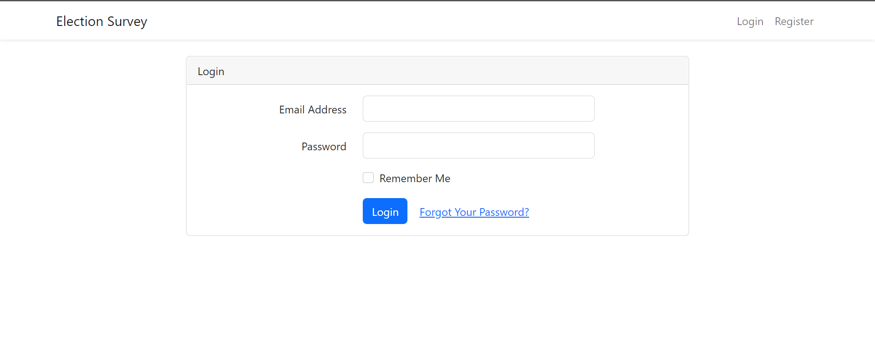
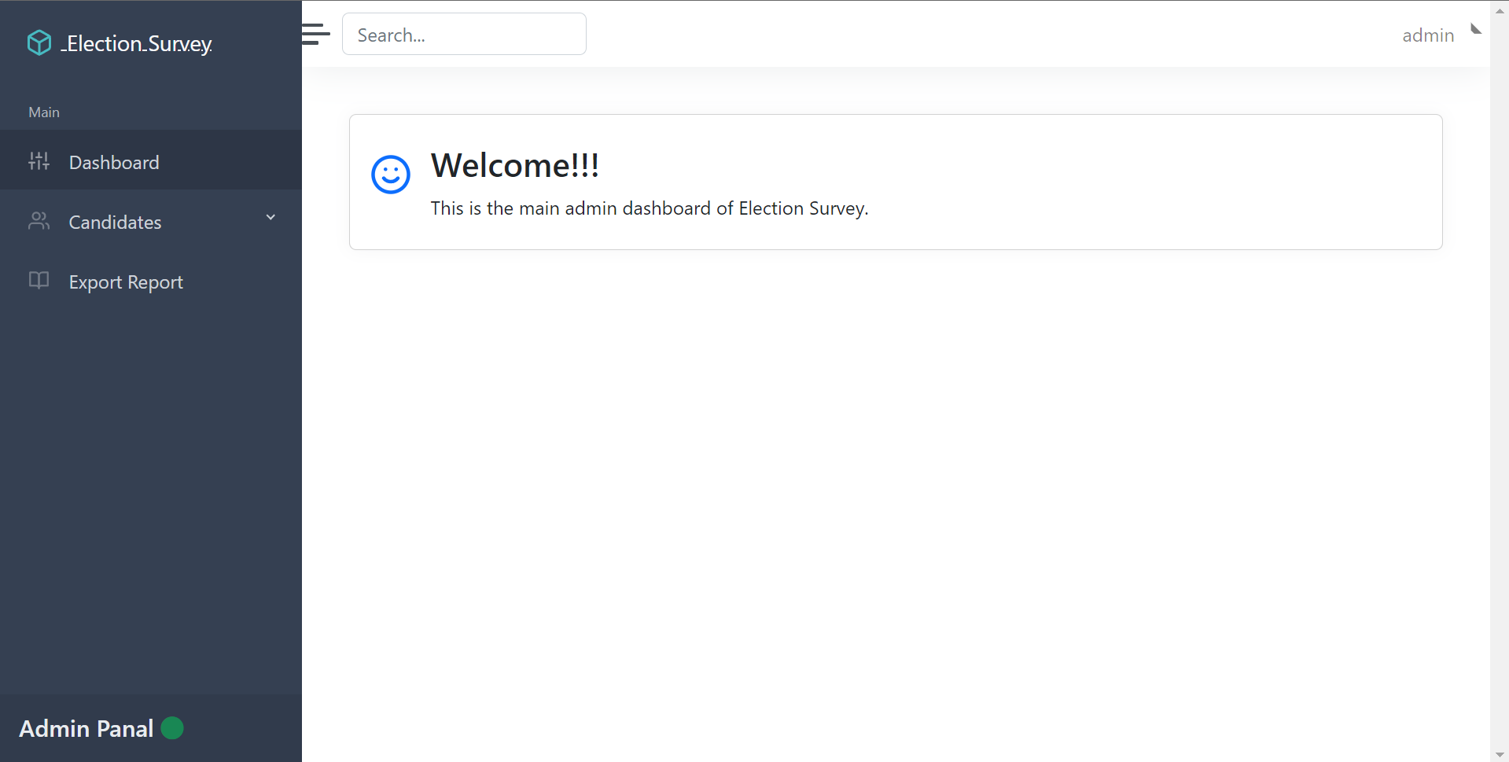
Project - 1
Election Survey System
Motivation-
Manual handling of MLA candidates information and general management tasks poses a number of challenges.
This is evident in procedures such as details management where an candidates is required to fill in a form which may take several weeks or months to be approved.
The details are not properly managed and edited and searchable through the paper (hardcopy) format as they are lot in numbers.
The use of paper work in handling some of these processes could lead to human error, papers may end up in the wrong hands and not forgetting the fact that this is time consuming.

Slide 4
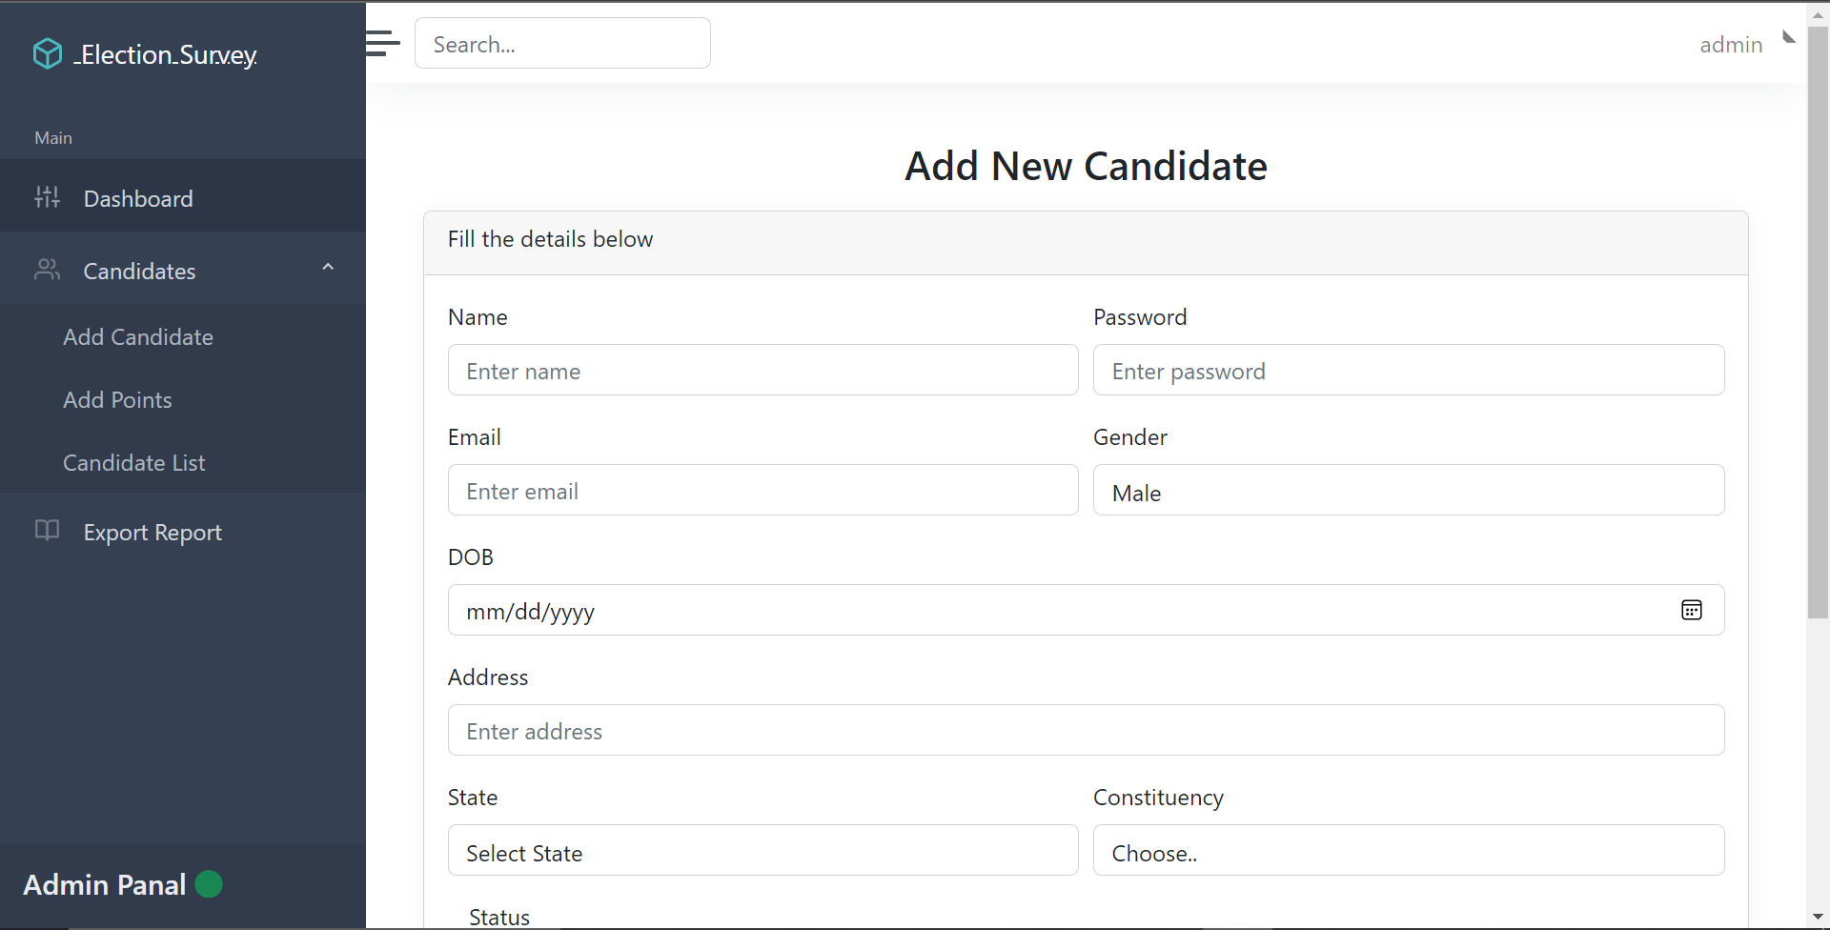
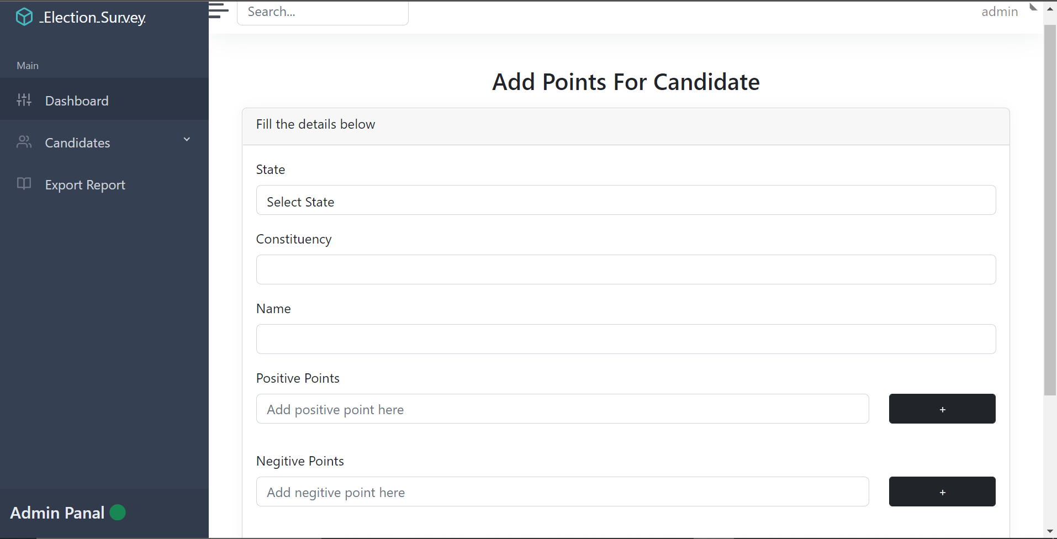
Project - 1
Election Survey System
Features-
Efficient way to reduce hardcopy usage for storing the government tasks.
This system to store all the details of the candidate such as name, address, state, constituency, gender, active status etc.
List of all candidates are available with the features such as edit, status change, profile view etc.
Their positive and negitive points details are also present there.
Details and finally report can be viewed/modified/generate etc. in required template. (provided by the company.

Slide 5
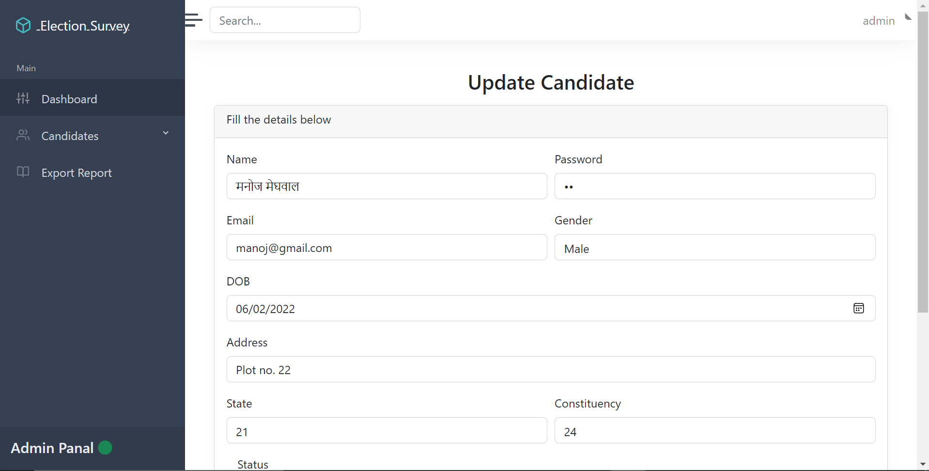
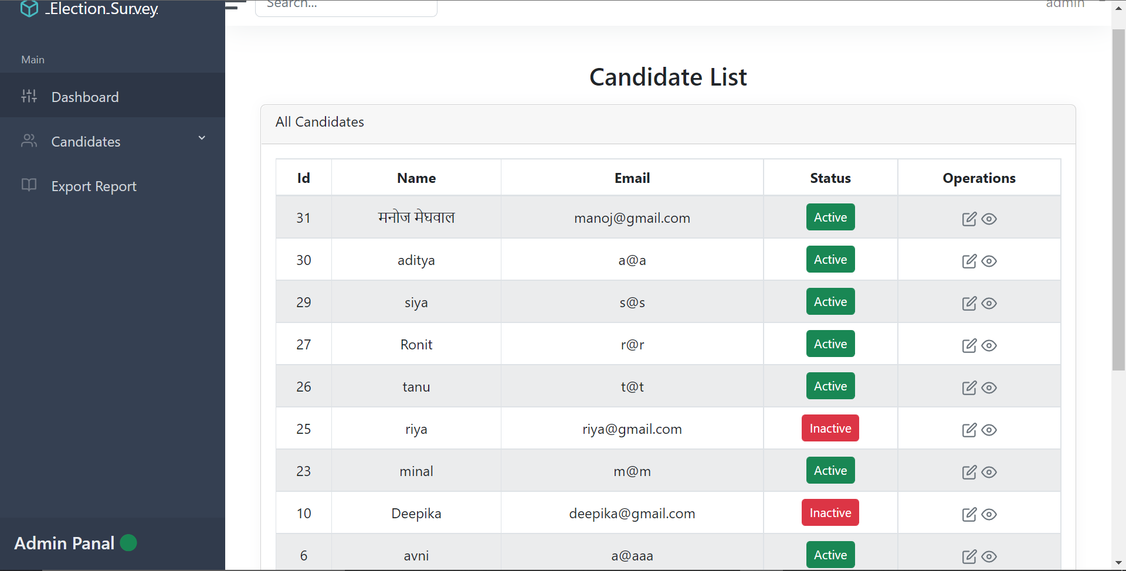
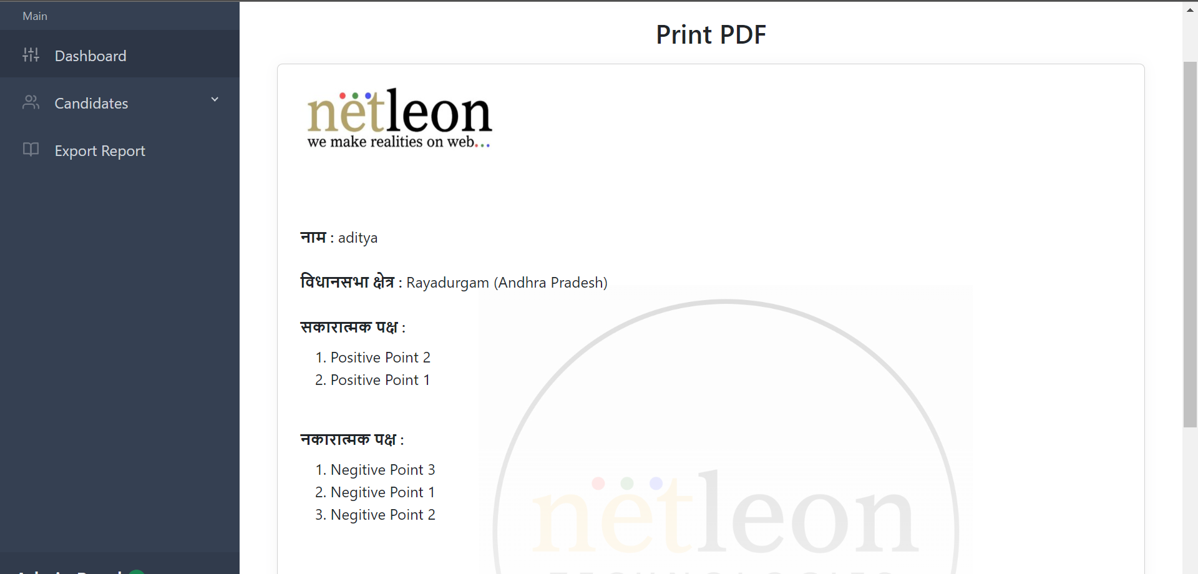
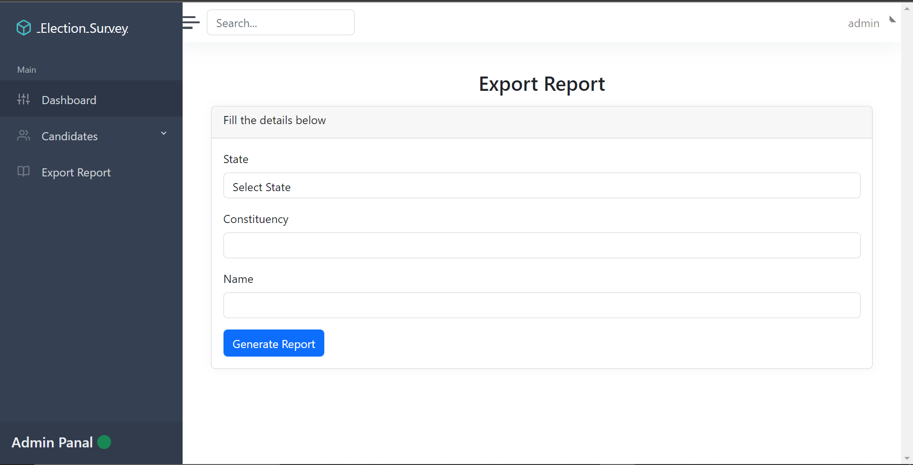
Project - 1
Screenshots

Slide 6
Project - 1
Database-
MySQL
The project is live on Netleon company website.
Technology Used-
Frontend and Backend-
PHP
PHP Laravel Framework
Bootstrap

